Slide 1
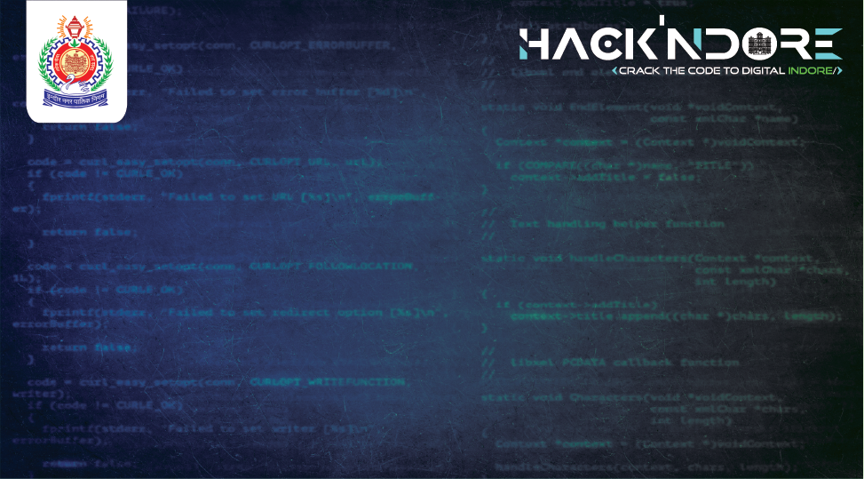
Enhanced Asset Management for Municipal Corporations
BIG BANG
Om Sharma
Vaibhav Waghmare
Vibhaeo Mudia
Yashraj Gharte
Taking City Ahead and beyond !

Slide 2

Problem Statement and Background
Problem Statement:
Enhanced Asset Management for Municipal Corporations
Background:
Indore Municipal Corporation faces challenges in tracking, maintaining, and optimizing assets.
Current systems are often fragmented and lack real-time tracking capabilities.

Slide 3
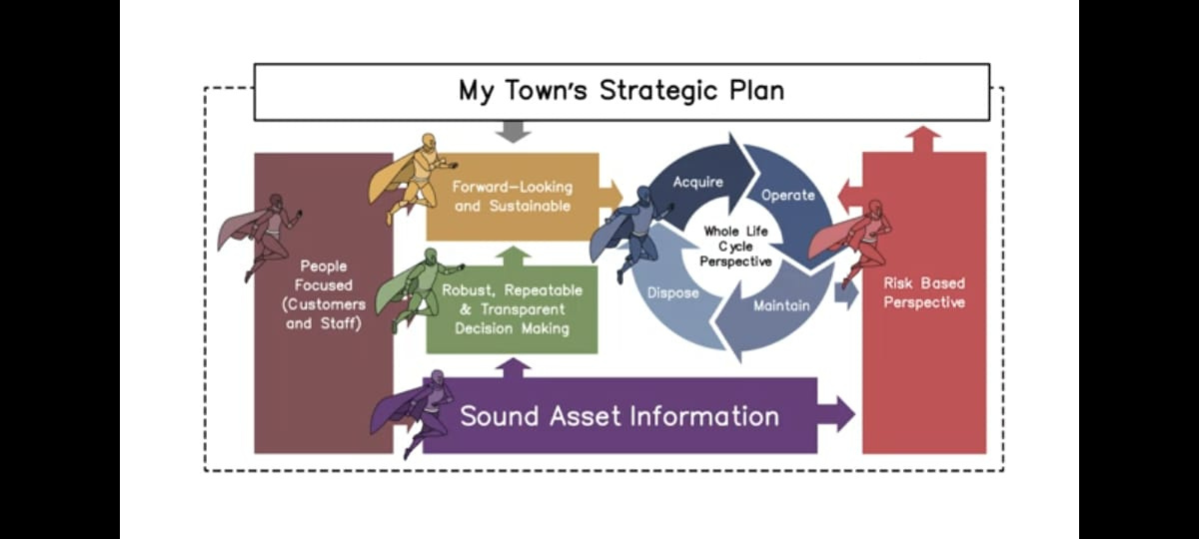
Problem Statement and Background

Slide 4
Our Approach to Asset Management
Asset List: Comprehensive database of municipal assets
GeoFencing: Precise location tracking of assets
Resource Management: Budget and inventory tracking
Predictive Maintenance: AI-driven maintenance scheduling
Public Engagement: Citizen reporting app(CityAlert)
Analysis Dashboard: A comprehensive dashboard for data visualization and analysis for each department assets and revenue.
Resource Allocation

Slide 5
Resource Allocation
Tools for Budget Planning:
Budget Tracking:
Monitoring expenditure against allocated budget in real-time.
Providing detailed reports on spending patterns and budget utilization.
Forecasting:
Predicting future budget needs based on historical data and upcoming projects.
Adjusting budget allocations to meet changing priorities and demands.
Decision-Support Systems:
Prioritization:
Evaluating asset conditions and prioritizing maintenance tasks based on urgency and impact.
Using criteria such as safety, usage intensity, and strategic importance.

Slide 6
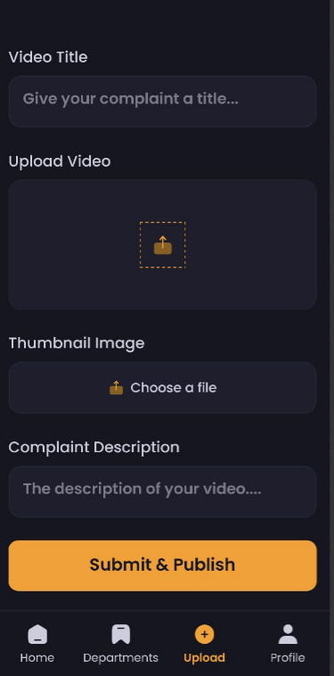
Objectives and Solution Overview
Objectives:
Asset Tracking and Inventory Management
Predictive Maintenance
Resource Allocation
Data Integration and Analytics
Community Engagement
Solution Overview:
CityAlert: A complaint-based app for citizens to report issues.
IndoreAssetX: A web portal for asset management focusing on roadways and streetlights.

Slide 7
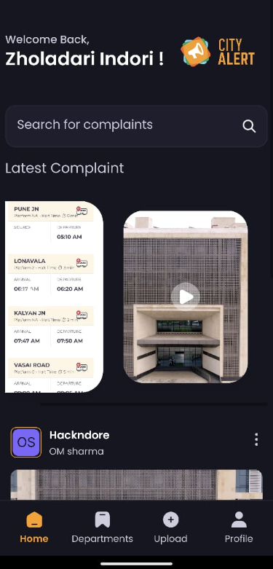
CityAlert App
Features:
Citizens can shoot and upload videos and photos of issues.
Complaints are routed to the corresponding department.
Public visibility of reported issues.
Issue Categorization (According to department)
Use case:
Complaint Tracking
Geotagging of Issues
Sentiment Analysis of Description
Chatbot Assistance
Technology Stack:
React Native (front -end)
AppWrite (Back end)

Slide 8
Predictive Maintenance
Purpose: To anticipate maintenance and replacement needs before they become critical.
Algorithms:
Random Forest Model
Why Random Forest?: It's robust to overfitting, handles large datasets well, and can capture complex interactions between features.
Data Collection
Dummy Data Generation:
Since you don't have access to real data, you can generate synthetic data that mimics the characteristics of real-world data.
This can include features such as:
Road Id,Road Location,Road Area Type,Road Condition managed time,Maintenance date,Type of Maintenance,Road length maintained (in km),Road Type,Contractor,Condition Metric,Budget,Damage log
Regular Inspections and Maintenance Logs:
Create a log of hypothetical maintenance actions and inspection results.

Slide 9
IndoreAssetX Web Portal
Features:
Overview of different departments (currently roadways and streetlights).
Predictive Maintenance:
Algorithms to predict maintenance/replacement needs.
Resource Allocation:
Tools for budget planning and expenditure tracking.
Decision-support systems for prioritizing asset needs.
Analytic chart:
Geotagging of inventory
.
User Interface
Screenshots of the portal (Dashboard, Asset Management Screen, Maintenance Scheduling Screen).
Technology Stack:
MernStack
Flask
Node
MongoDB

Slide 10
Overview of Departments
Roadways:
Description: Overseeing the construction, maintenance, and repair of city roads.
Challenges:
Identifying areas requiring immediate maintenance.
Tracking the status of repairs and upgrades.
Ensuring that the road network remains safe and functional.
Streetlights:
Description: Managing the installation, maintenance, and replacement of street lighting.
Challenges:
Monitoring the functionality of streetlights.
Addressing outages promptly to ensure public safety.

Slide 11
GeoFencing of Inventory:
Description:
Visualizing the location and status of all assets on an interactive map.
Providing a comprehensive view of the city’s infrastructure.
Benefits:
Quickly identifying problem areas and addressing them promptly.
Tracking maintenance progress and ensuring complete coverage.

Slide 12
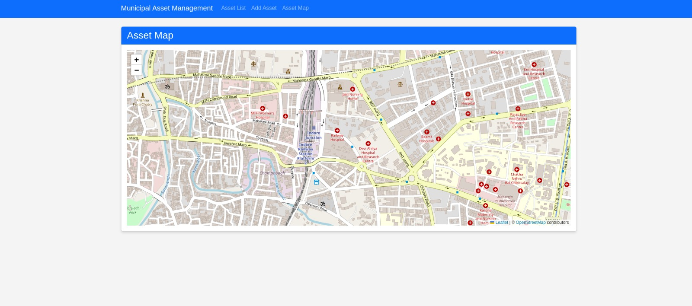
GeoFencing

Slide 13
Data Integration, Analytics, and Community Engagement
Data Integration:
Centralized platform integrating data from sensors, maintenance logs, and financial systems.
Analytics:
Insights into asset performance and utilization.
Visualization tools for easy data interpretation.
Future Enhancements:
Integration of more departments and assets.
Advanced analytics and reporting features.

Slide 14
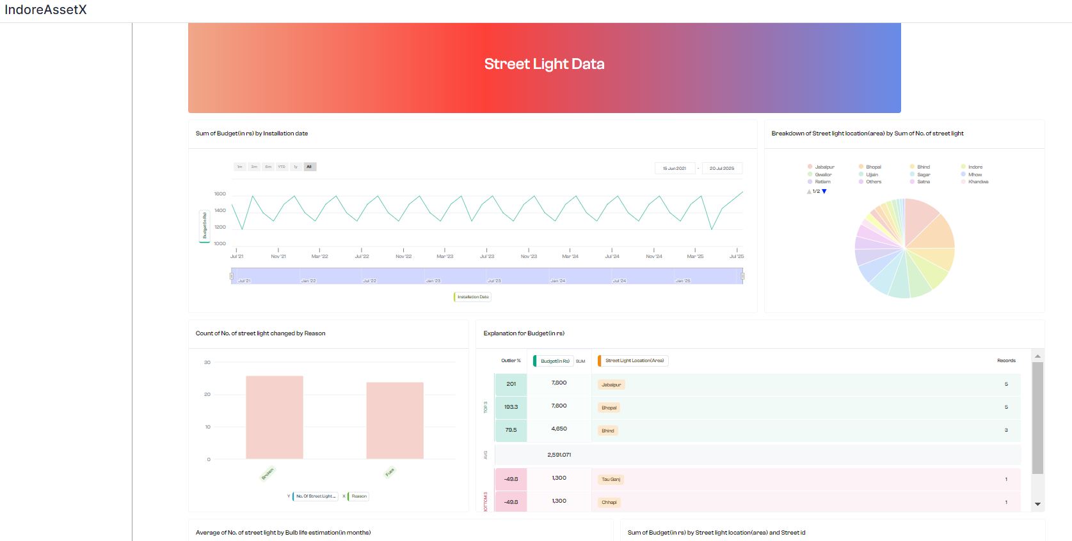
Analytic Charts
Description: A comprehensive dashboard providing real-time data visualization and analysis for informed decision-making.
Features:
Interactive Charts: The dashboard includes a variety of interactive charts to visualize data trends and patterns.

Slide 15
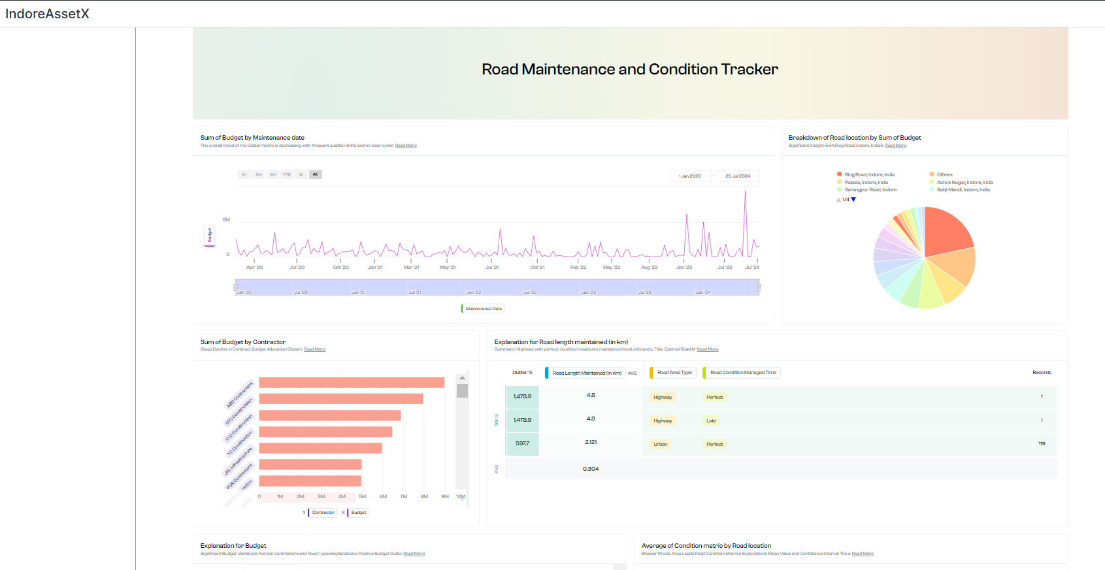
Dashboard

Slide 16


